Slide 1
Practice Improvement Institute
Rapid Job Placement Series: From Interview to Placement—those first 30 Days
January 16, 2015 9:00-10:00

Slide 2
Rapid Job Series Description
January 8, 2015 9:00-10:00 Webinar
Part I: Within 3 hours! From confirming a job exists to identifying candidates. This module will share tools and strategies to ensure the job readiness of program participants.
January 9, 2014 9:00-10:00 Webinar
Part II: Within 72 hours! Candidate Identification to Interviews! This module will discuss the candidate selection process, engagement of participants and the obvious and less obvious components of readiness process for interviews—including preparing employers.
January 15, 2015 9:00-10:00 Webinar
Part III: Now is NOT the time to ask… Is the family on board? This module will address ways to engage families and help them overcome their fears.
January 16, 2015 9:00-10:00 Webinar
Part IV: First 30 Days of Employment . This module discusses the challenges that can arise during those critical first days.

Slide 3
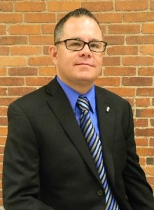
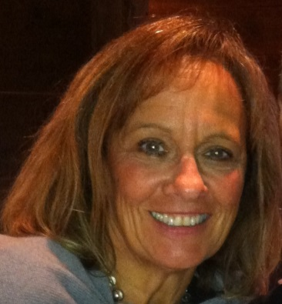
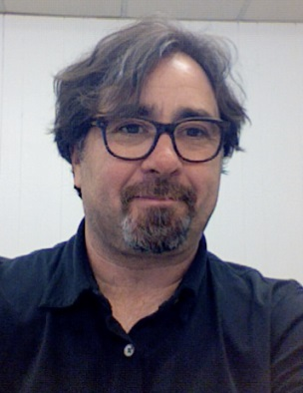
Practice Improvement Institute Faculty: Rapid Job Placement Series
Lorrie Lutz
Fedcap’s Chief Strategy Officer
Eugene Gloss
Director of Programs in New England
Donna Keefe
New England Director of Admission and Client Services
Wil Edwards
Business Developer
Ken Renaud
Senior Transition Support Specialist

Slide 4
Celebrate Success
When a participant is hired— CELEBRATE
Ring a Bell
Have popcorn!
Tote Board on the Wall
Pictures of individuals who have been hired posted –including the logo of the business
Use their hiring as a way to advance the enthusiasm of other participants ...
And to inspire staff!
First Paycheck Celebration

Slide 5
Create Shared Learning
Spend time in group settings asking the new employee what they hope to obtain from employment, how they feel about working in the community, what they plan to do with their first paycheck, etc.
Job Club (in a community setting when possible such as a coffee shop or a park), where individuals who are working can talk about their experiences and learn from one another.
What surprised them
What they like the most about employment
What issues are causing them concern
What the job has taught them about their long term career goals
If they have developed natural supports (helpful colleagues) within the job setting

Slide 6
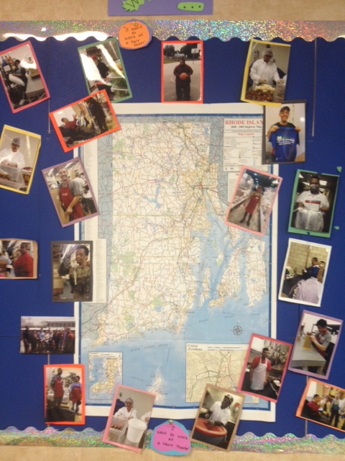
Job Board

Slide 7
Time Between Being Hired and Starting Work
May be a short period of time...so there is a sense of urgency!
Ensure proper clothing is in place
Plan food for breaks and lunch
Go over the first day’s routine (practicing to ensure timeliness, reduction in stress)
Revisit transportation plan
Review job expectations –practice
Complete paperwork (much better than waiting until the first day of employment)
Expect that both the individual and the family may express concern/fear—stay connected to the family to avoid any last minute issues

Slide 8
First Day on the Job
No different than any one of us!
Individual (and/or their family) may become fearful
Family may want to join the participant for a few minutes at the jobs site that first day (if the participant says yes)
It is critical that...
The participant sees us to ensure that they know they are supported
Remember sometimes they believe that leaving the workshop or center based environment means that they are leaving their “family”
Orientation of consumer and the job coach.

Slide 9
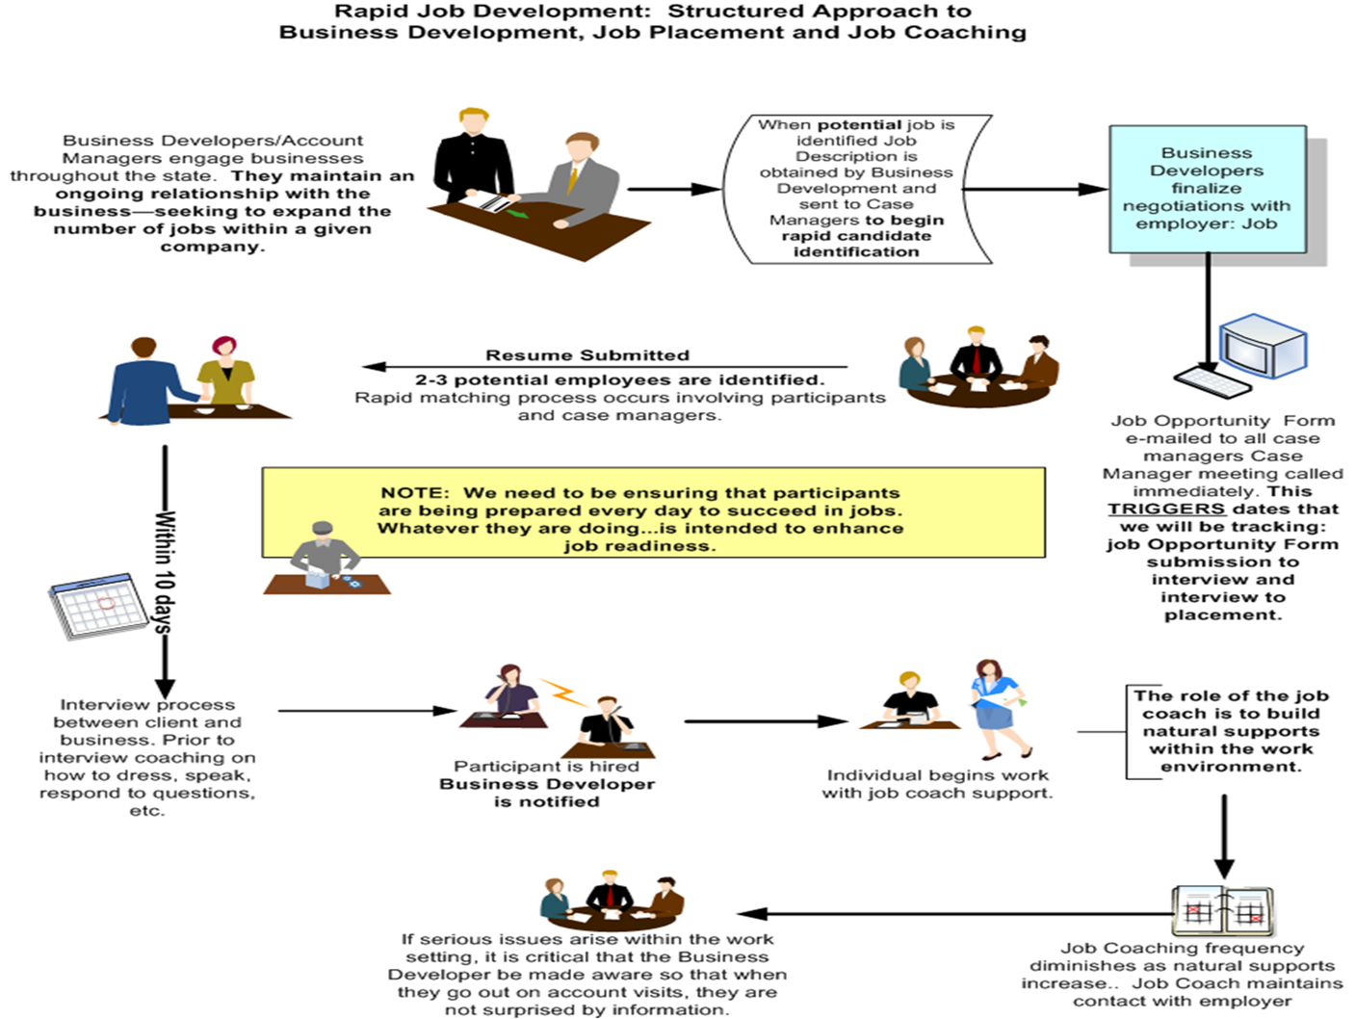

Slide 10
Communication Between Team Members
Once the consumer gets the job—that is when our work really begins.
Remember we promised a team of support—so we need to make that team of support visible to the Business.
Regular Communication between the Business Developer , the Job Coach and Case Manager occurs weekly.
If issues arise at the site...make sure that the supervisor /day to day manager knows EXACTLY who to contact:
We strongly recommend that it be the Business Developer—maintain that relationship with the business
The Job Coach should communicate directly to the Business Developer AND the case manager
Issue (such as hygiene) may result in an impromptu team meeting or a case manager –family conversation.
May have the person come to the agency first before going to the job
Do not reduce communication until the individual has stabilized.

Slide 11
There are times when...
The job is not what the person thought it would be...
No matter how much preparation we provide, the reality is that getting up and going to work everyday takes discipline, energy, and commitment on the part of the participant AND the support of the family.
Remember that the workshop environment did not mirror (in most cases) the employment environment.
Even when they do not feel like it, consumers need to be on time, take limited breaks, and come to work every single day they are scheduled.
Both participants and family members can start to resent the rigors of work.

Slide 12
When This Happens
Use Integrated Day Activities to address flaws in performance at the site
Find ways to keep folks inspired about work
Continue the conversation about the benefits of employment to the individual
Continue family engagement
Increase hours on the job
Learn new aspects of the business
AND/OR Look for new career options.
Job is not the last job. Sequence to the new job respecting the employer—DO NOT burn bridges.

Slide 13
RETENTION BUILDS SKILLS AND COMPETENCIES
Developed a Retention Model (Our promise to the Employer)
Tier One—Significant Support
Tier Two – Job Coach Checks in Weekly
Tier Three—Job Coach Checks in every 2 weeks to one month
Currently we have nearly 60 people who have worked 3+ months
Of those, nearly 30 have worked 6+ months
Of those nearly 20 have worked over one year

